Slide 1

IᑎᑕOG 2.0
Once you've lost your privacy, you realize you've lost an extremely valuable thing
DEEPAK YADAV 16BCS2082

Slide 2
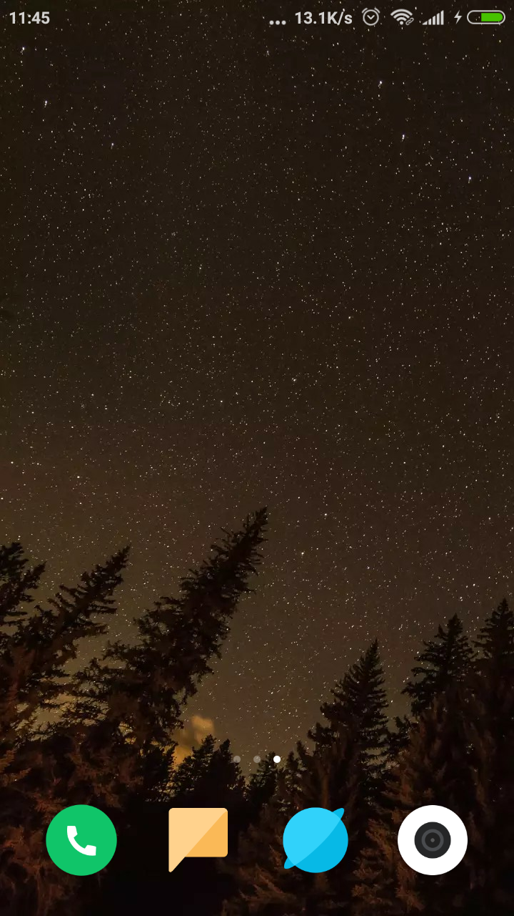
Lets Start with opening Incog 2.0
Incog 2.0 is obviously very much Incognito so look harder. Empowering the Façade for you

Slide 3
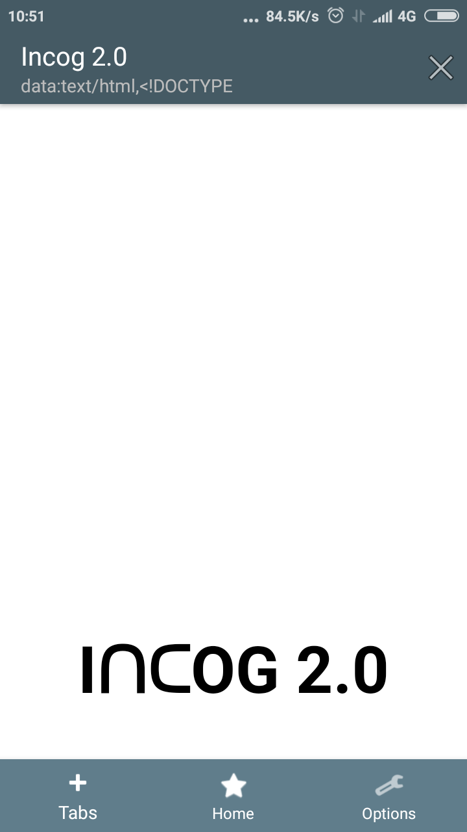
Simple in looks and feel
Incog 2.0 is built with keeping user experience in mind so that we provide the user with best experience.
Definitely better than Chrome.

Slide 4
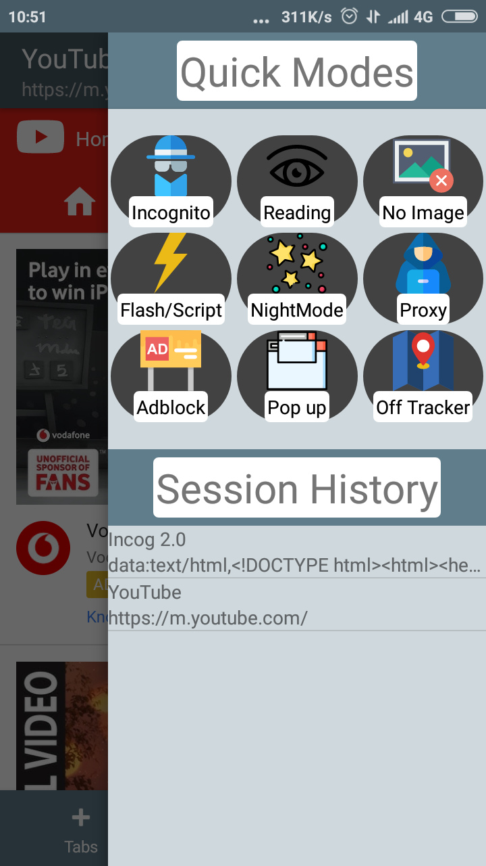
Multiple Toggles at one place
Quick toggles as all given at one place so that you don’t have to work too hard.
We know you are lazy.

Slide 5
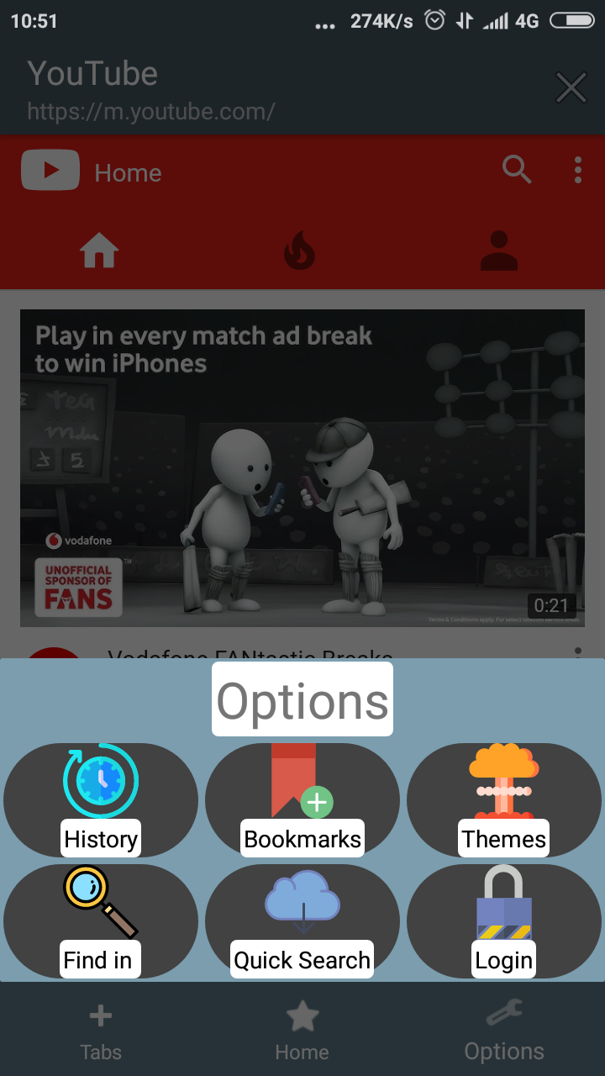
More options to Deal with
Other options are given at auto hiding bottom navigation that compromises many more tools.
Can’t let you forbid us.

Slide 6
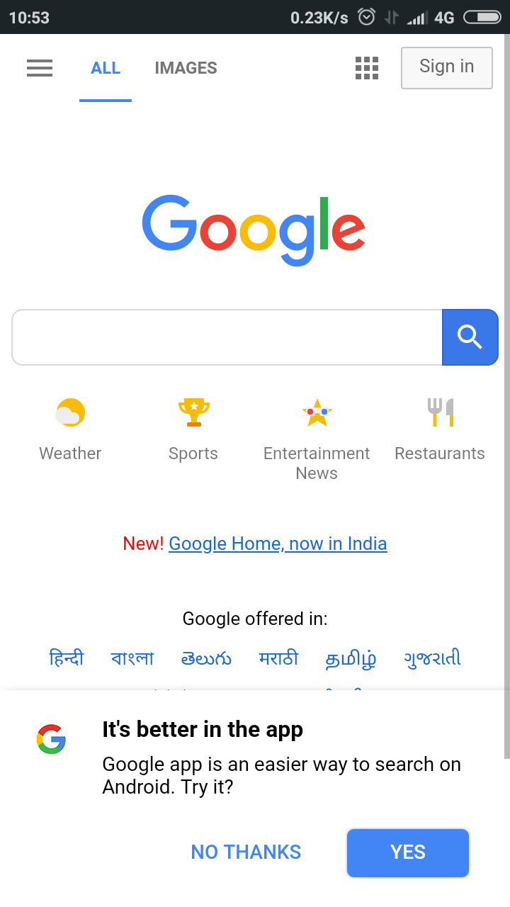
Google on your fingertips
Just with one simple touch,
get google
ask google
forget google

Slide 7
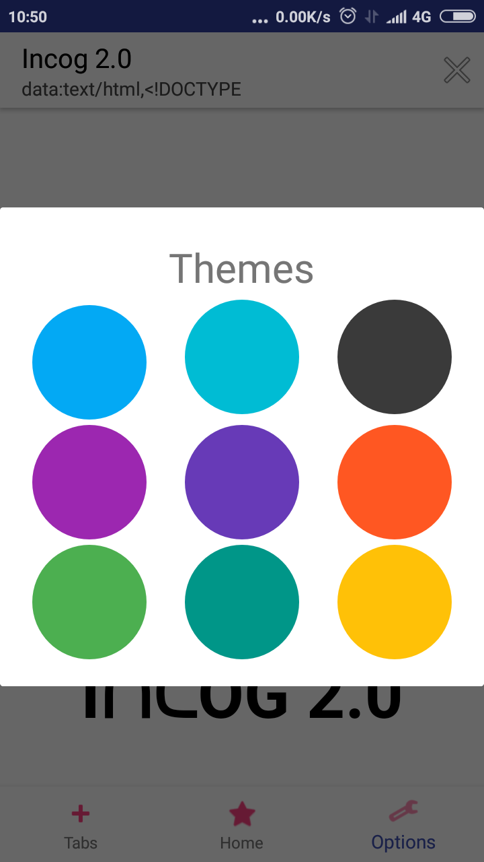
World is colorful and so is Incog 2.0
With multiple theme options pick the best one that suits your Style.

Slide 8
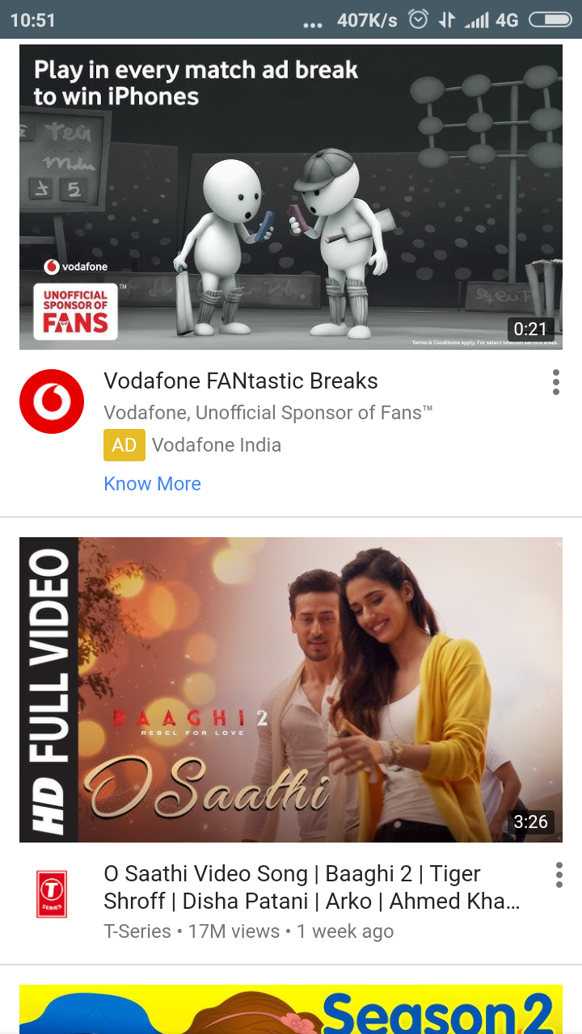
With huge power of web, comes huge experiences of web, so why be stuck to 70%
With Coordinator layout, user gets a full screen experience of the world wide web.

Slide 9
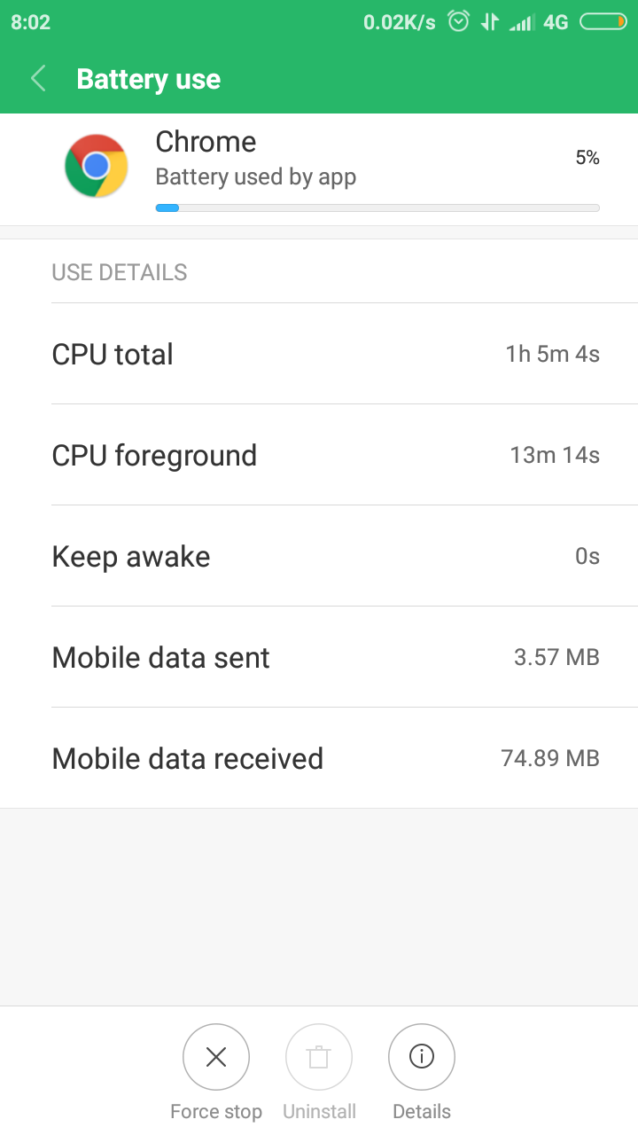
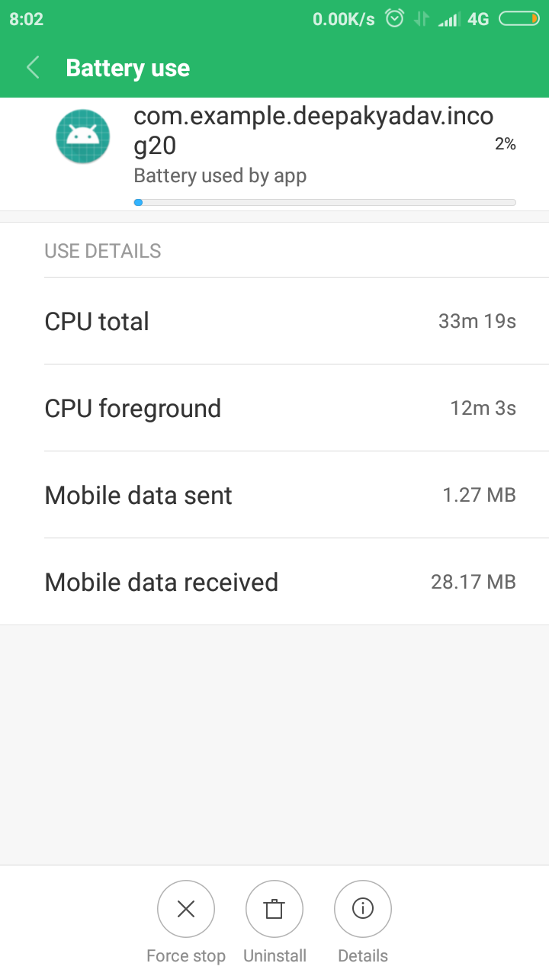
Optimized Battery Life and 2x faster in loading
Incog 2.0 is very light in weight therefore reduce battery consumption and loads faster than heavy browsers.

Slide 10
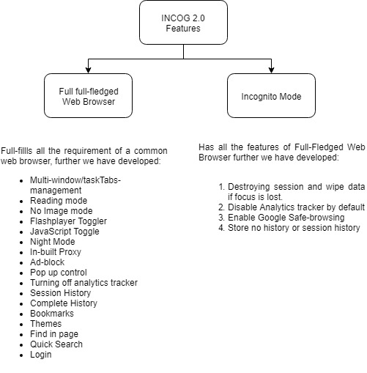
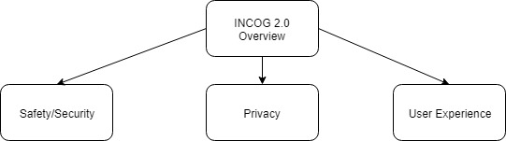

Slide 11
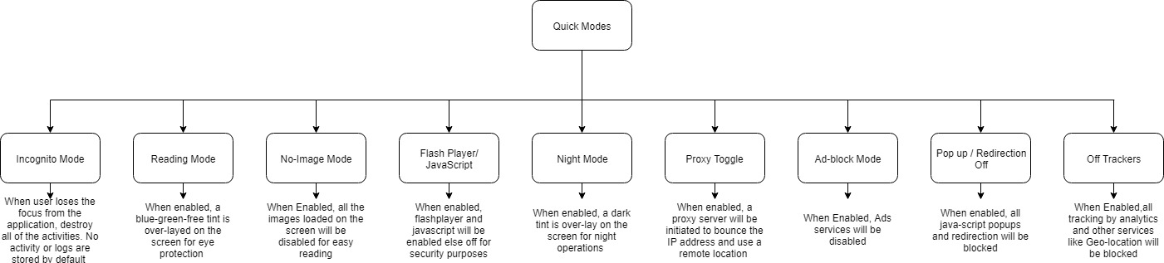
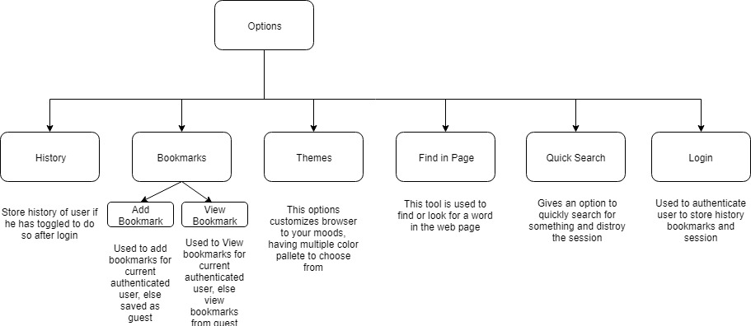
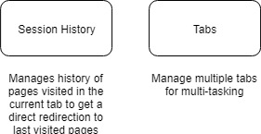

Slide 12
We are not google, we don’t know that you are watching this.
Thanks anyways..

